Slide 1

SELLING
ON
AVITO
GUIDE
Prepared by:
Anna Gauthier
Notes:
Good morning everyone! My name is Anna Gauthier. I am a representative from Avito, here to introduce you to a platform where you can post general goods for sale, jobs, real estate, personals, cars for sale, and services. Avito.ru is the most popular classified site in Russia and is the second biggest classified site in the world after Craigslist.

Slide 2
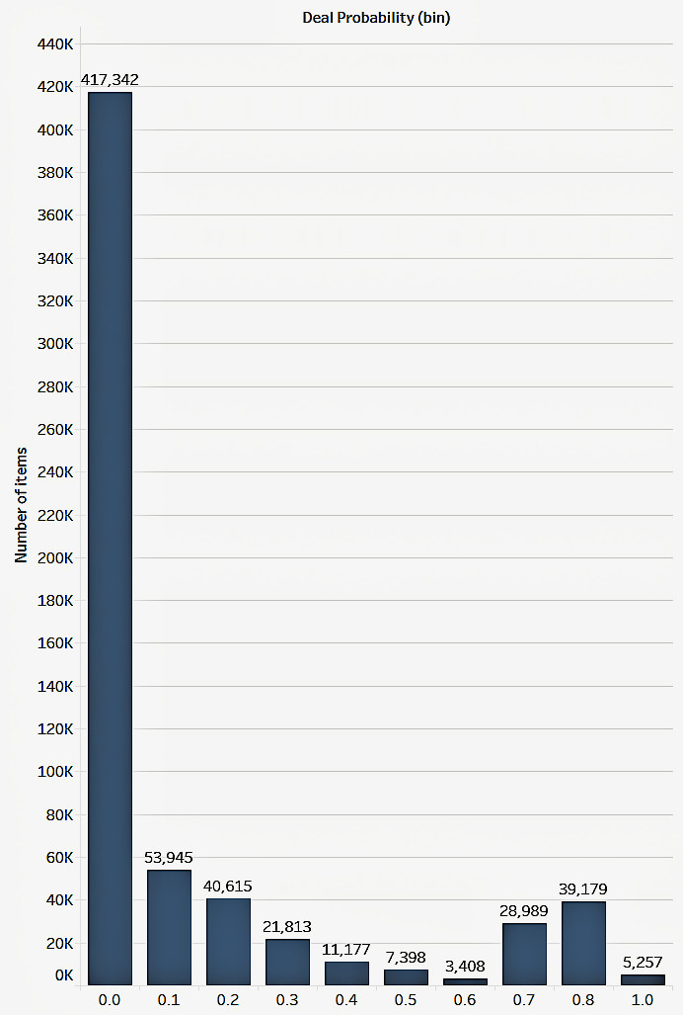
Deal Probability is the target variable. This is the likelihood that an ad actually sold something.
Out of 1,048,576 items:
417,342 items have a deal probability of 0
39.8% out of the total
5257 items have a deal probability of 1.0
0.005% out of the total
Goals:
Increase the numbers of items with a deal probability of 1.0
Decrease the numbers of items with a deal probability of 0.0
Notes:
Our main goal on Avito is to get your item to sell. Our target variable is deal probability which is calculated by looking at every part of the listing including image quality, Title length and details in the description. In order to understand the sale activity on Avito, we will break down the total number of items into bins, the size of which is 0.10.The graph you see shows an alarmingly large number of items which have a deal probability of 0. It consists of 417,342 item which make up for 39.8% of the total 1,048,576 items. We also see 5257 items with a deal probability of 1 which makes up a mere 0.005% of the total number of listings.

Slide 3
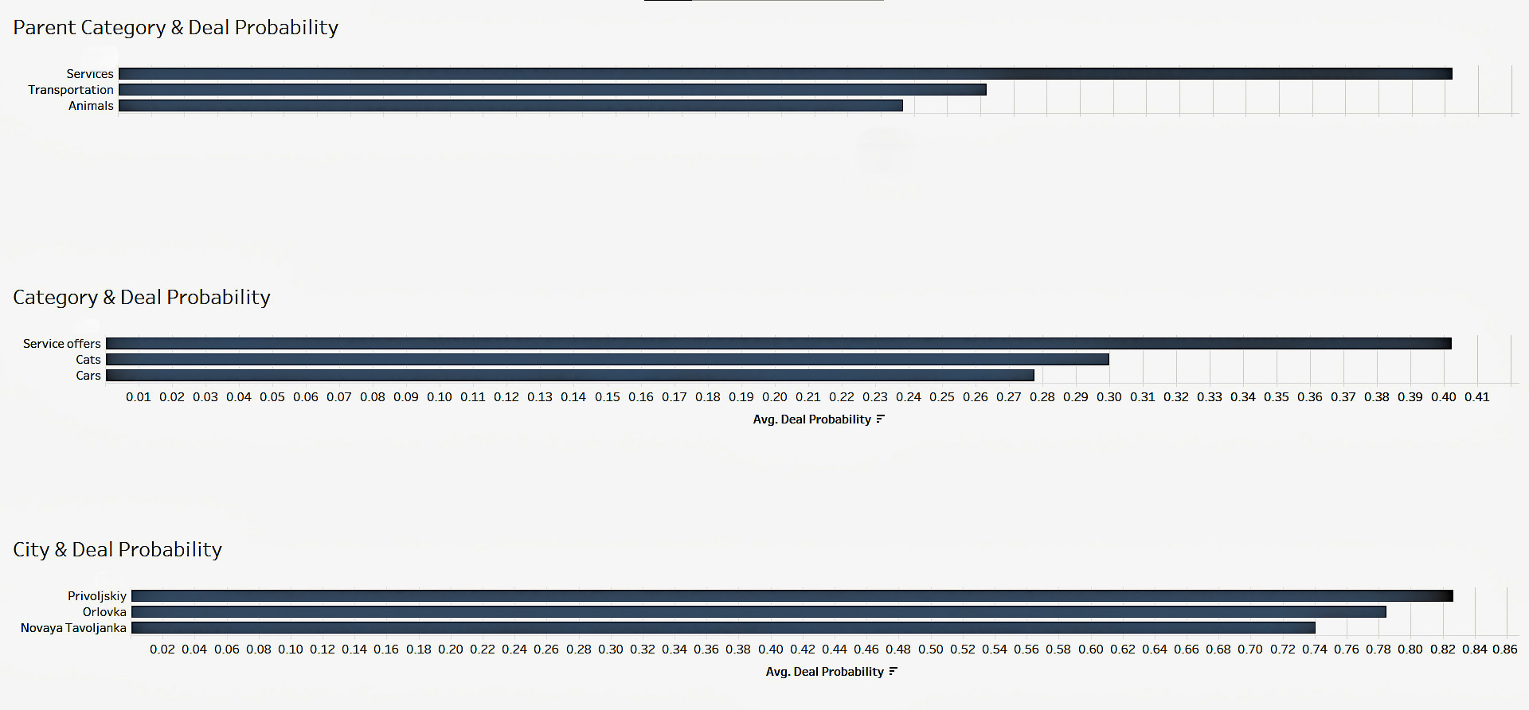
Notes:
In a categorical breakdown, we will focus on the factors with the highest deal probability.
The top 3 in each category are as follows:
parent category includes services(0.4), transportation(0.26) and animals(0.23).
Category includes Service offers(0.4), cats (0.3), cars(0.27)
City includes Privoljsky (0.82), Orlovka (0.78), and Novaya Tavolljanka (0.74)

Slide 4
t Tests
Testing the significance of:
Parameter 1
statistic=-17.16, pvalue=7.870320512801951e-66
REJECT NULL HYP
Parameter 2
statistic=-104.38, pvalue=0.0
REJECT NULL HYP
Parameter 3
statistic=-172.07, pvalue=0.0
REJECT NULL HYP
Parent Category | Category | Param 1 | Param 2 | Param 3
Personal Belonging | Clothing, Shoes and Accessories | Women’s clothing | Pants | Size
Notes:
The next few important things are Parameter 1, 2 and 3 which are essential subcategories further describing the item which makes it easier to filter through the website. An example would me “Personal belongings” which is a parent category - “Clothing” which is a category -”Women’s Clothing”-”Women’s pants”-and further.

Slide 5

A PICTURE IS WORTH A THOUSAND WORDS
Notes:
Other “not so important” factors are photos. When it comes to listing an item, one of the first things people look for is the picture of the item. Make sure it is a clear, well lit photo of the items, showing every detail well.

Slide 6
ASKING PRICE VS. SELLING PRICE
Seller’s desired range
Price too high and you lose buyers
Common price range
Further exploration includes:
-chi testing on multiple parameters to see which factors have the biggest impact on deal probability
-analysis of images associated with every item ID to see the influence on deal probability
-other ways to expand the market for individuals to list items in order to support smaller business and cater to smaller cities
Price too low and you lose value
Buyers’ desired range
Notes:
Price can be a deal breaker for most. Remember, Avito has millions of users and even more listings. Make sure your item is worth the selling price you put it for. We all want to get the most out of every sale, but make sure it is within the common price range for the product category you’re listing.

Slide 7
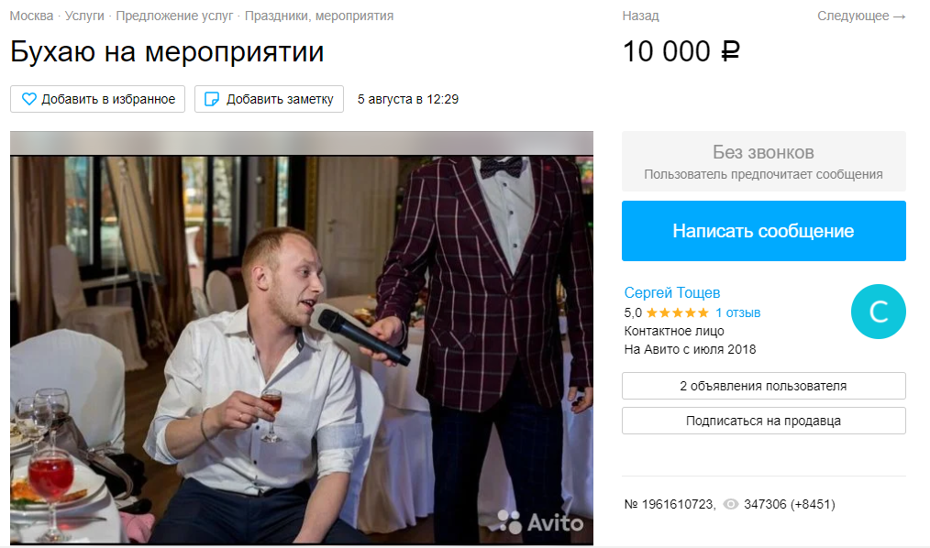
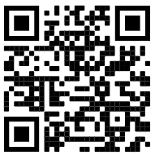
THANKS!
FEATURED LISTING
Do you have any questions?
E: akuryachaya@mail.ru
Want to see the data + the presentation?
Scan the QR code!
Notes:
I hope you got some useful information in order to become a seller on Avito and my advice will make your listings more likely to sell! Our featured listing for today is by Сергей Тощев who is offering his services of a drunk at special gatherings for $135. His goal is to drink enough to make you look sober. He also charges extra for fights of no more than 2. If you have further questions about my presentation, feel free to email or check out the QR code for a link to my GitHub. Thank you!

